Slide 1
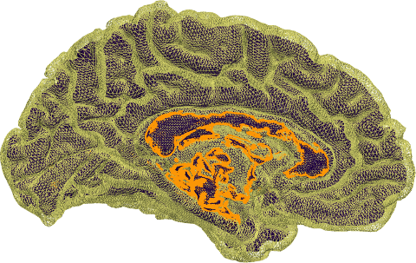
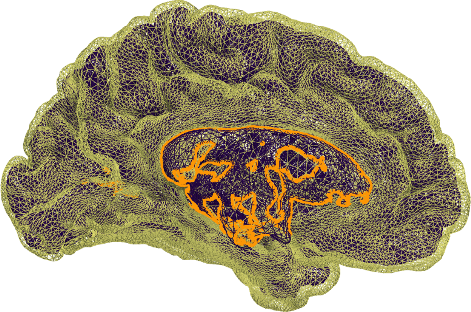
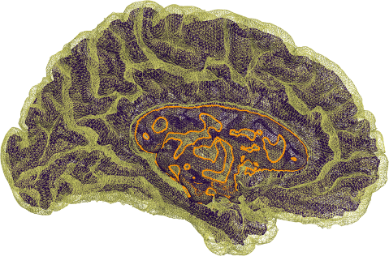
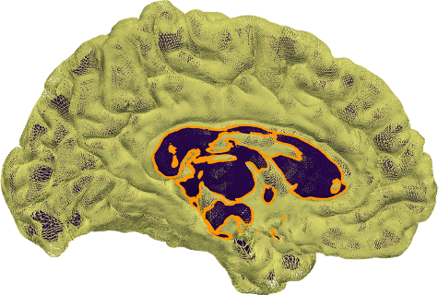
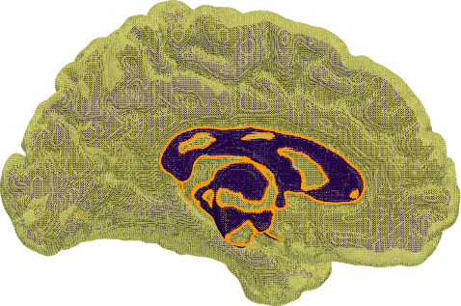
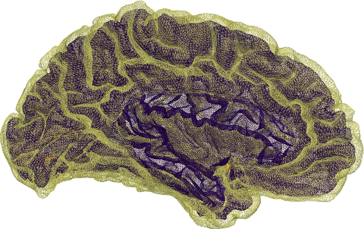
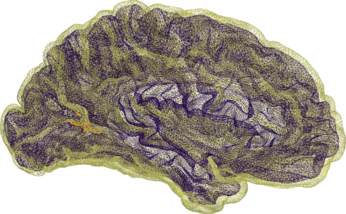
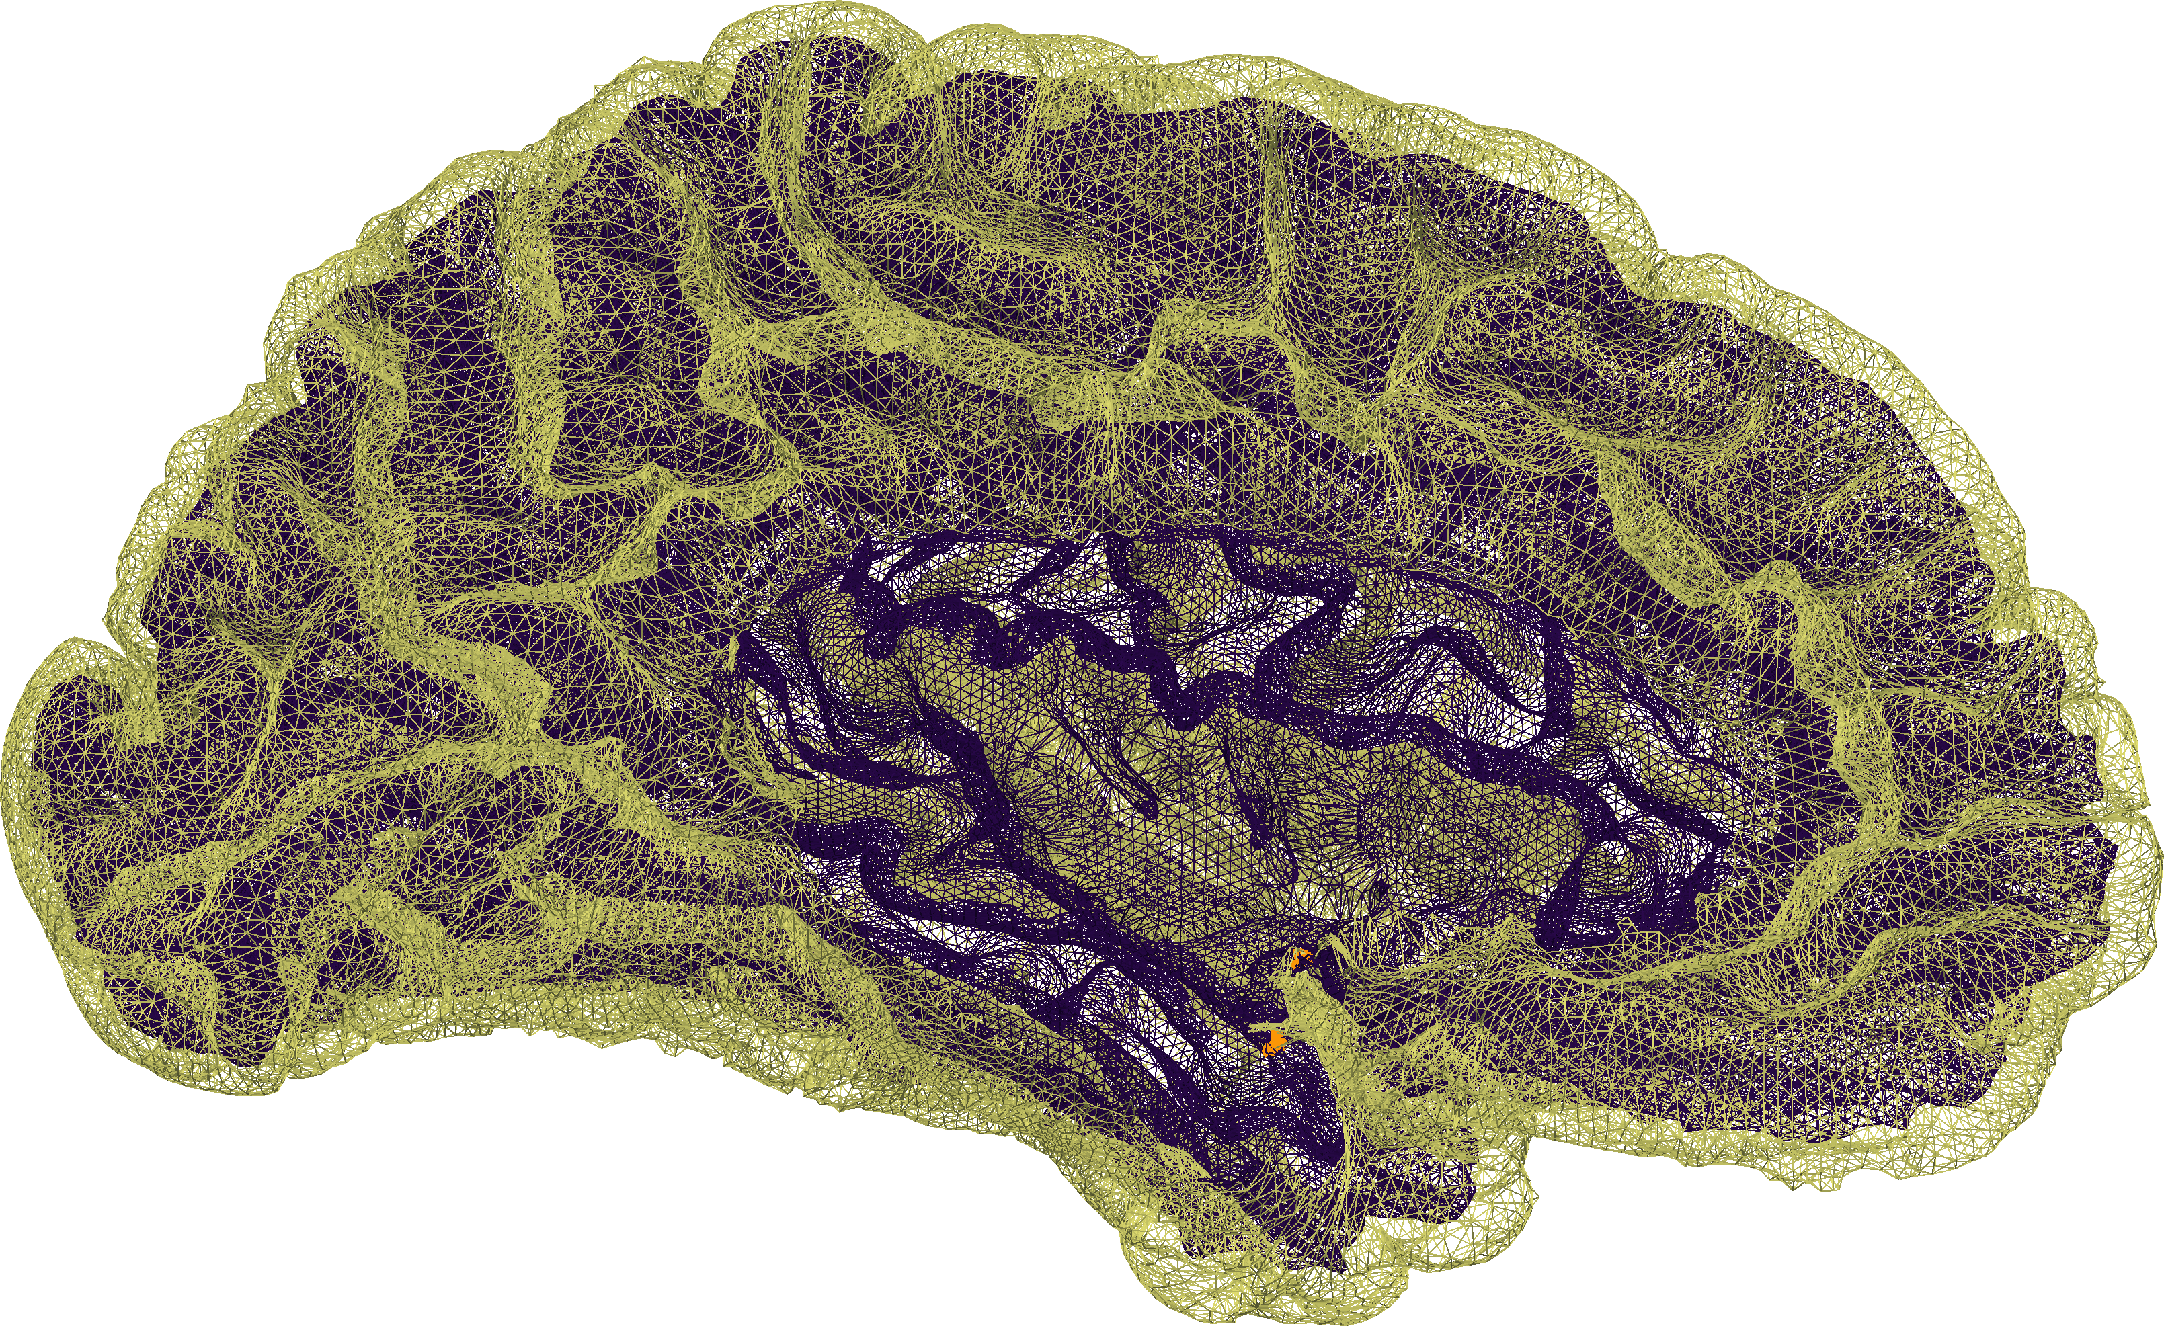
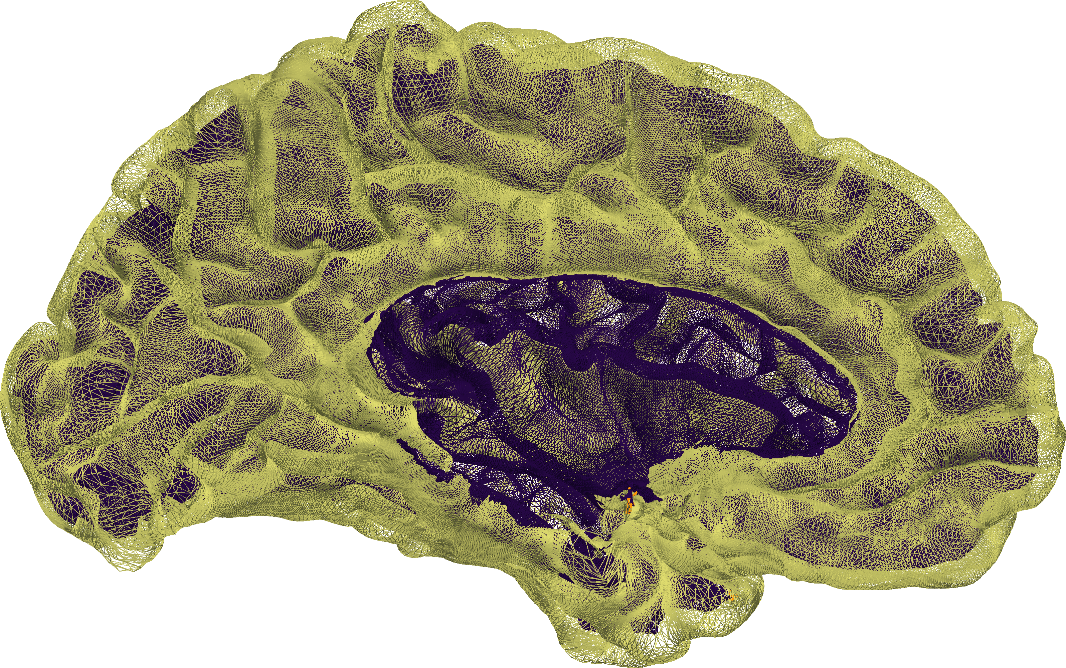
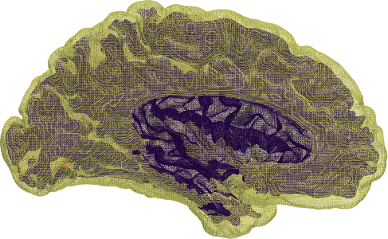
CortexODE
Vox2Cortex
FreeSurfer
CorticalFlow
DeepCSR
spherical topology
3.58 %
2.22 %
1.93 %
1.45 %
0.66 %
medial wall removed
0.25 %
0.23 %
0.25 %
0.22 %
0.02 %
White
Pial
Intersection
Modified on Jul 19, Wed, 2023
The Final One

